Slide 1

ZONING MAP UPDATE
Planning & Zoning Commission Public Hearing
September 25, 2019

Slide 2
GOALS
Align with the Sunset Hills Comprehensive Plan
Modernize Zoning Standards
Create a comprehensive, contemporary, user-friendly code

Slide 3
7. Design Guidelines
1. District Standards
2. Development Standards
3. Sign Ordinance
5. Subdivision Ordinance
6. Administrative Standards
4. Planned Unit Development
ZONING UPDATE PROCESS

Slide 4
ZONING MAP

Slide 5
Current Zoning Districts
NU – Nonurban District
R-1 – Single Family Residential District
R-2 – Single Family Residential District
R-3 – Single Family Residential District
R-4 – Single Family Residential District
R-5 – Single Family Residential District
R-6 – Single Family Residential District
C-1 – Commercial District
PD – Planned Development Districts

Slide 6
Current Planned Development Districts
PD – Planned Development Districts
PD-R – Residential
PD-RC – Residential/Cluster Homes
PD-BC – Business Commercial
PD-LC (A) – Limited Commercial
PD-LC (B) – Limited Commercial
PD-LC (C) – Limited Commercial
PD-MXD – Mixed Use
PD-LS – Lifestyle
PD-LI – Light Industrial

Slide 7
EXISTING DISTRICT | EXISTING MINIMUM LOT AREA (sq/ft) | TOTAL # LOTS | # NON- CONFORMING | % NON- CONFORMING
NU | 130,680 | 129 | 90 | 70%
R-1 | 43,560 | 1,047 | 494 | 47%
R-2 | 20,000 | 490 | 139 | 28%
R-3 | 15,000 | 562 | 37 | 7%
R-4 | 10,000 | 539 | 47 | 9%
R-5 | 7,500 | 83 | 3 | 4%
R-6 | 5,000 | 331 | 19 | 6%
C1 | 20,000 | 89 | 22 | 25%

Slide 8
Residential District Changes

Slide 9
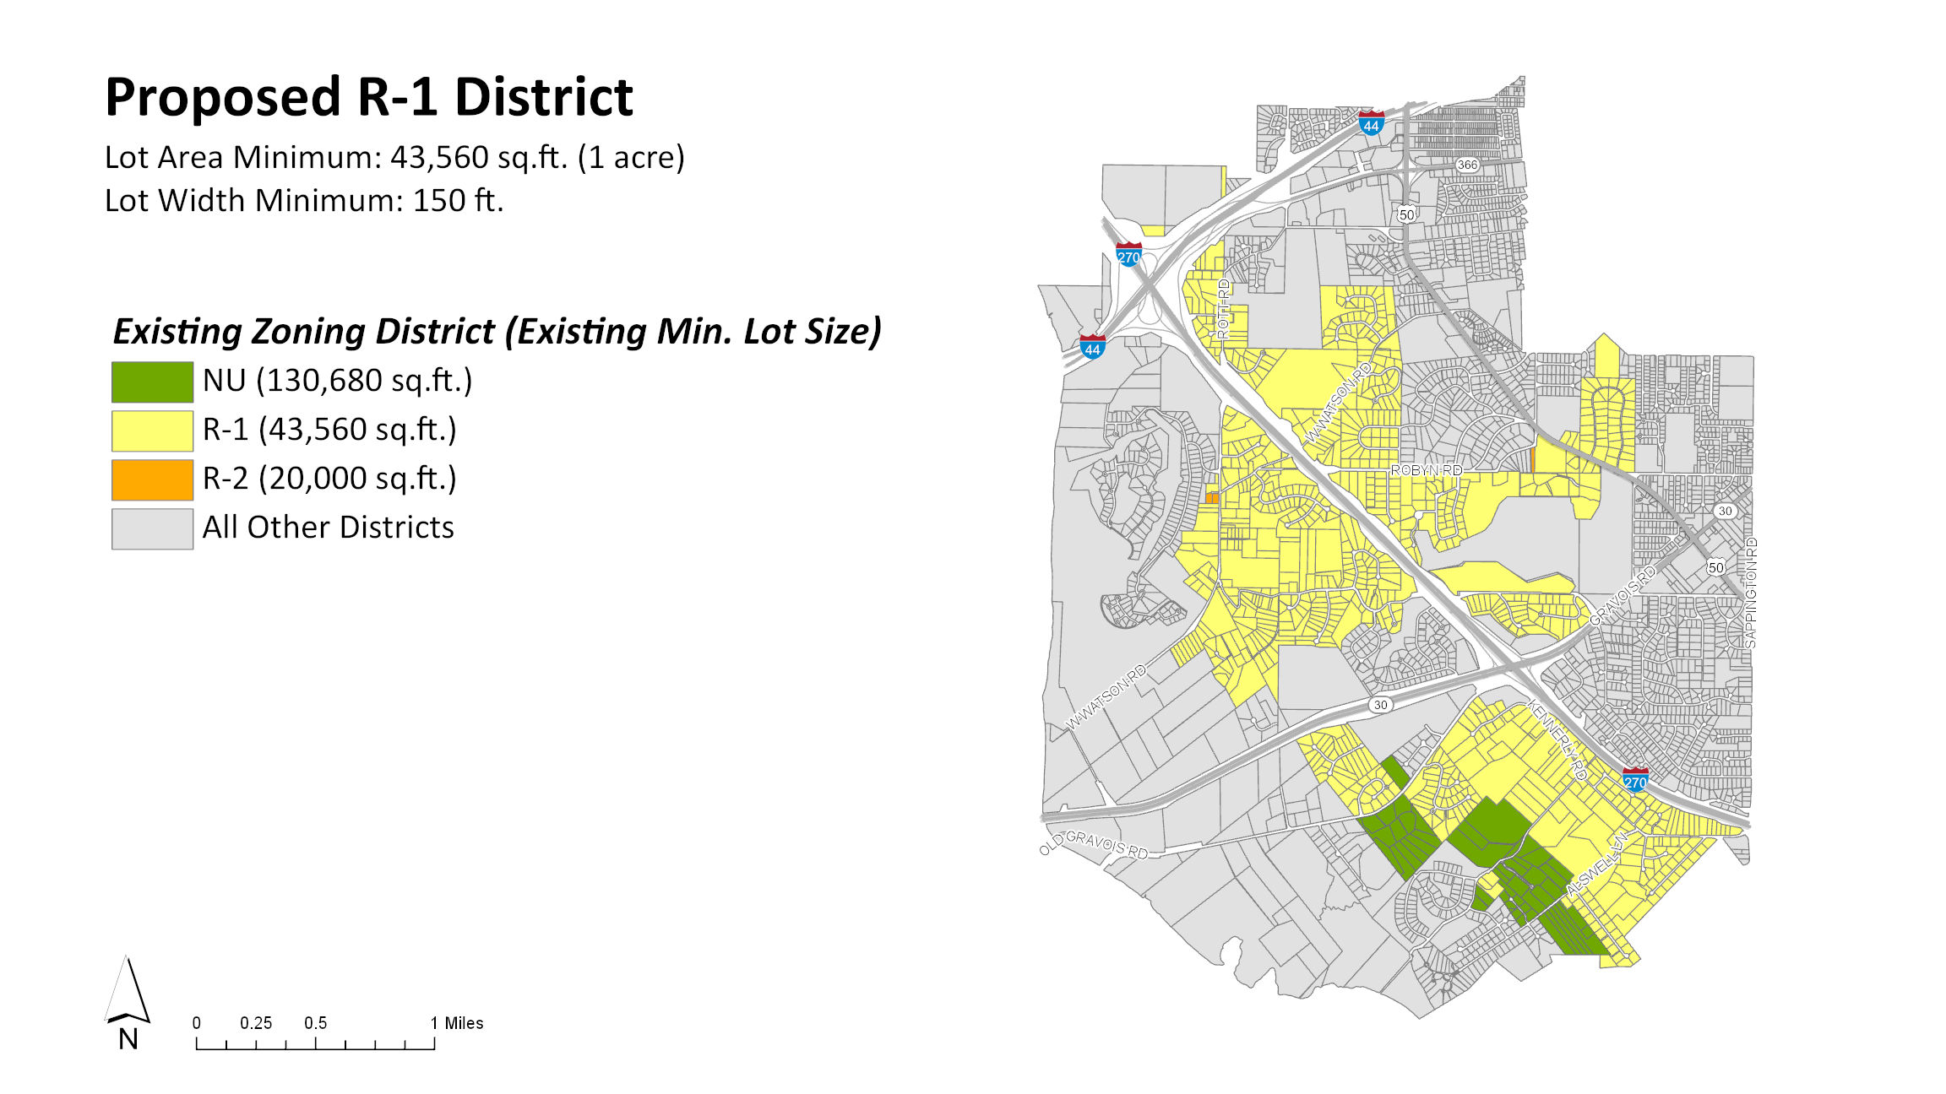

Slide 10
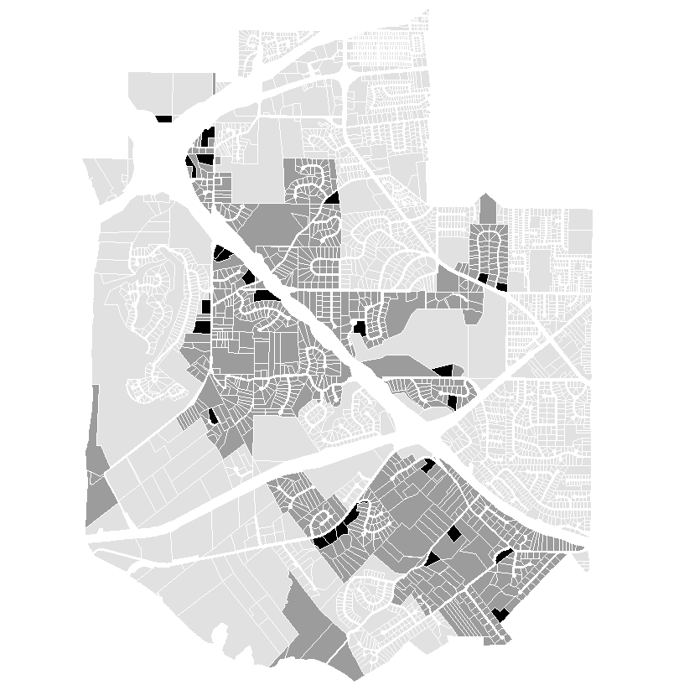
Proposed R-1 District
Lot area minimum: 1 acre
Lot width minimum: 150 feet
Formerly:
NU
lot area minimum: 3 acres
lot width minimum: 150 feet
R-1
lot area minimum: 1 acre
lot width minimum: 150 feet
R-2
lot area minimum: 20,000 sq/ft
lot width minimum: 80 feet
 | _{R-1 District Parcels}
 | New Opportunities for Subdivision
 | _{All Other Parcels}

Slide 11
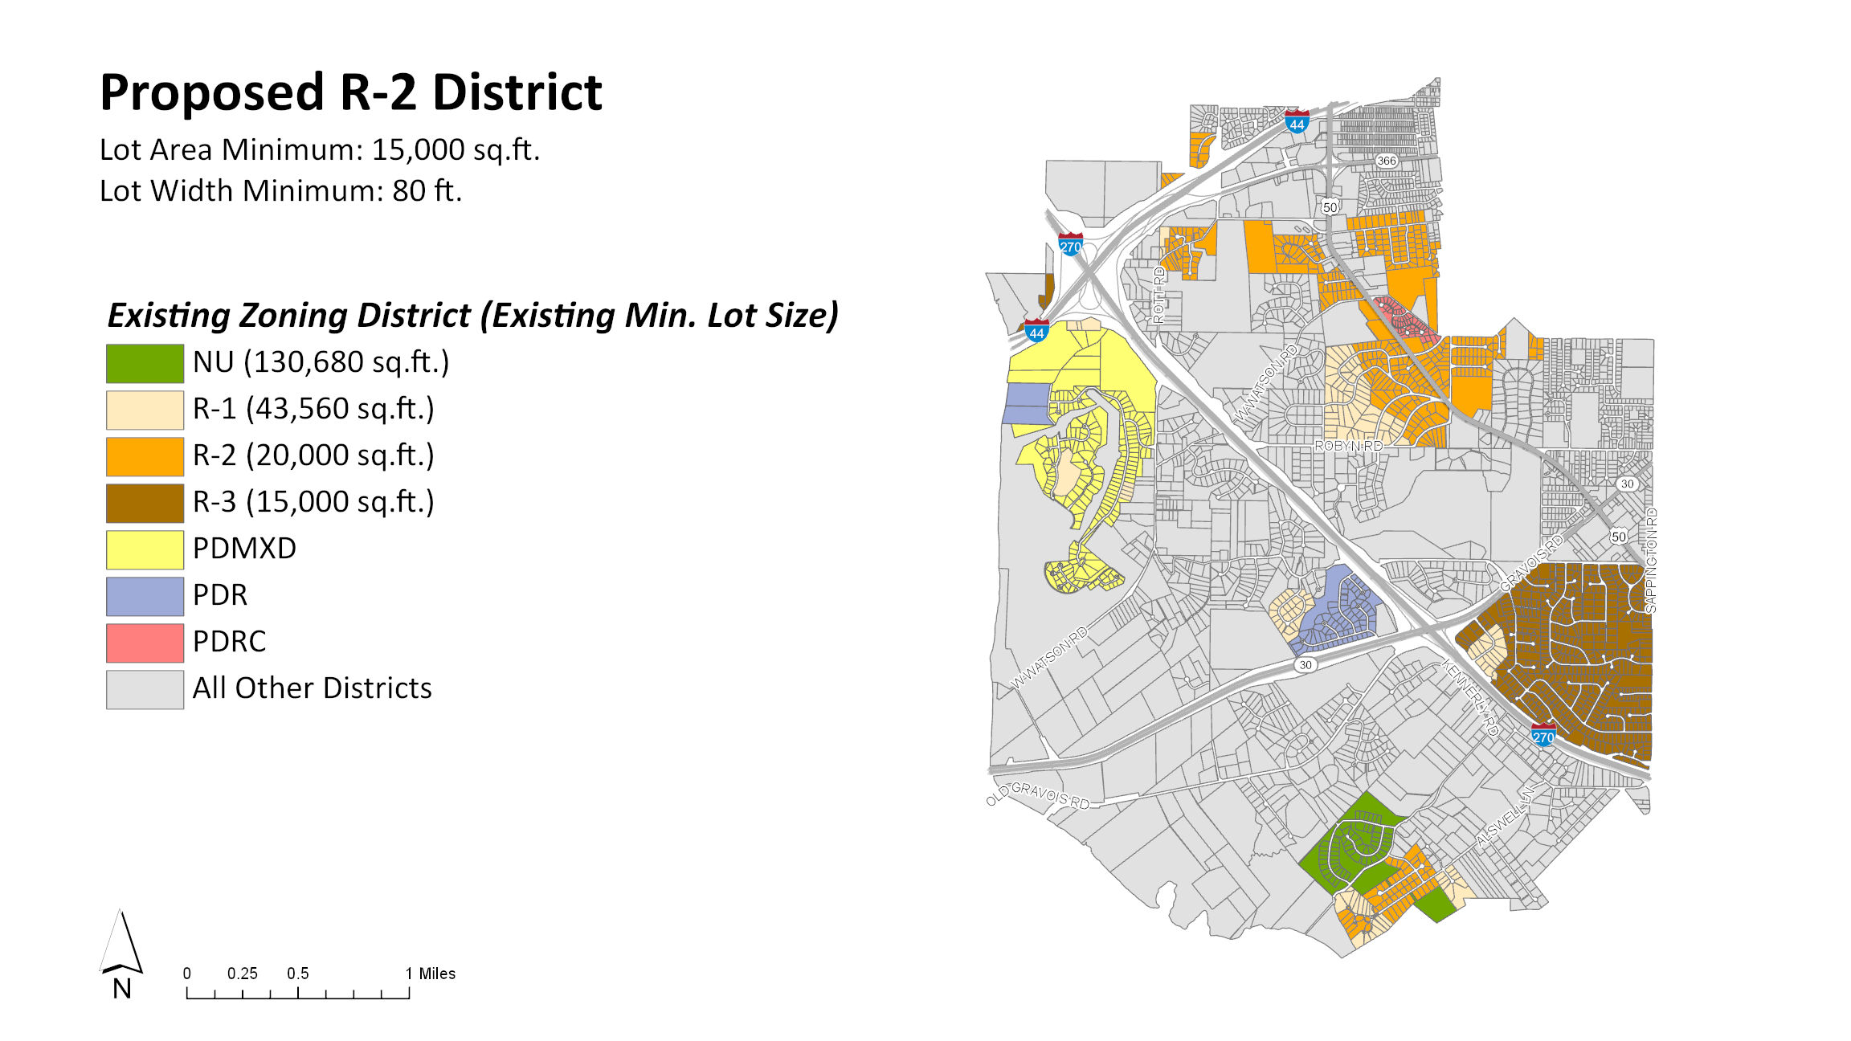

Slide 12
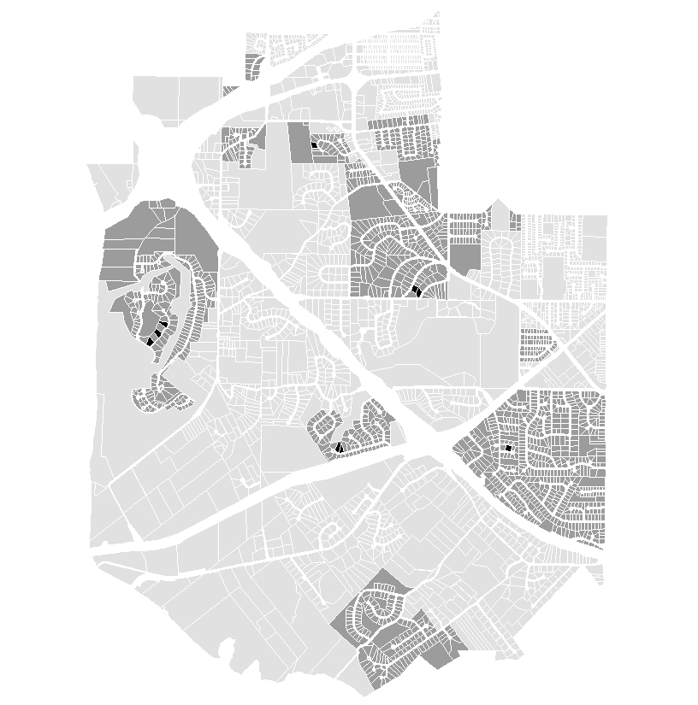
Proposed R-2 District
Lot area minimum: 15,000 sq/ft
Lot width minimum: 80 feet
Formerly:
NU
Lot area minimum: 3 acres
Lot width minimum: 150 feet
R-1
Lot area minimum: 1 acre
Lot width minimum: 150 feet
R-2
lot area minimum: 20,000 sq/ft
lot width minimum: 80 feet
R-3
lot area minimum: 15,000 sq/ft
lot width minimum: 80 feet
 | _{R-2 District Parcels}
 | New Opportunities for Subdivision
 | _{All Other Parcels}

Slide 13
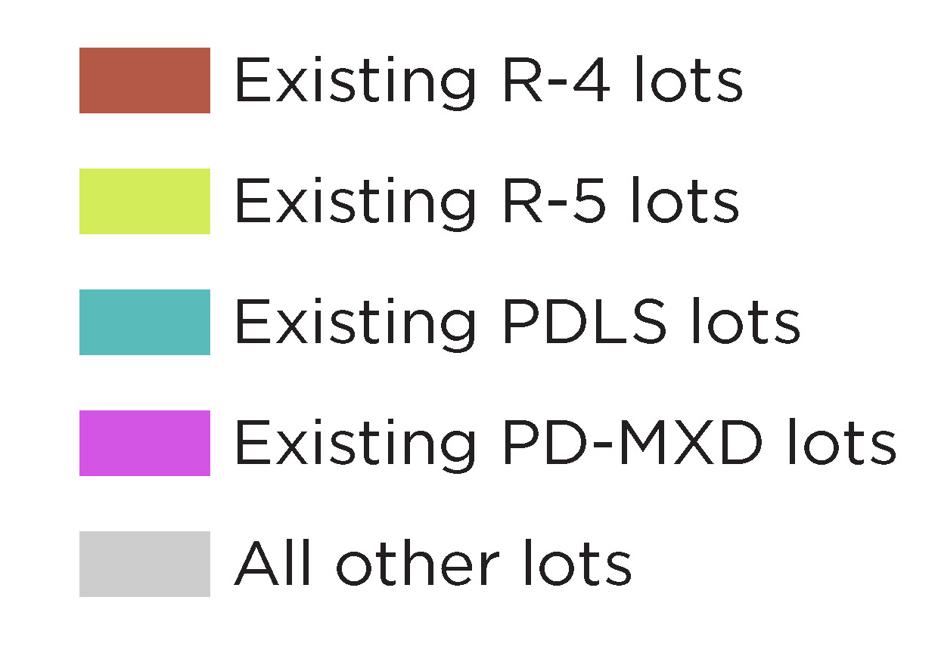
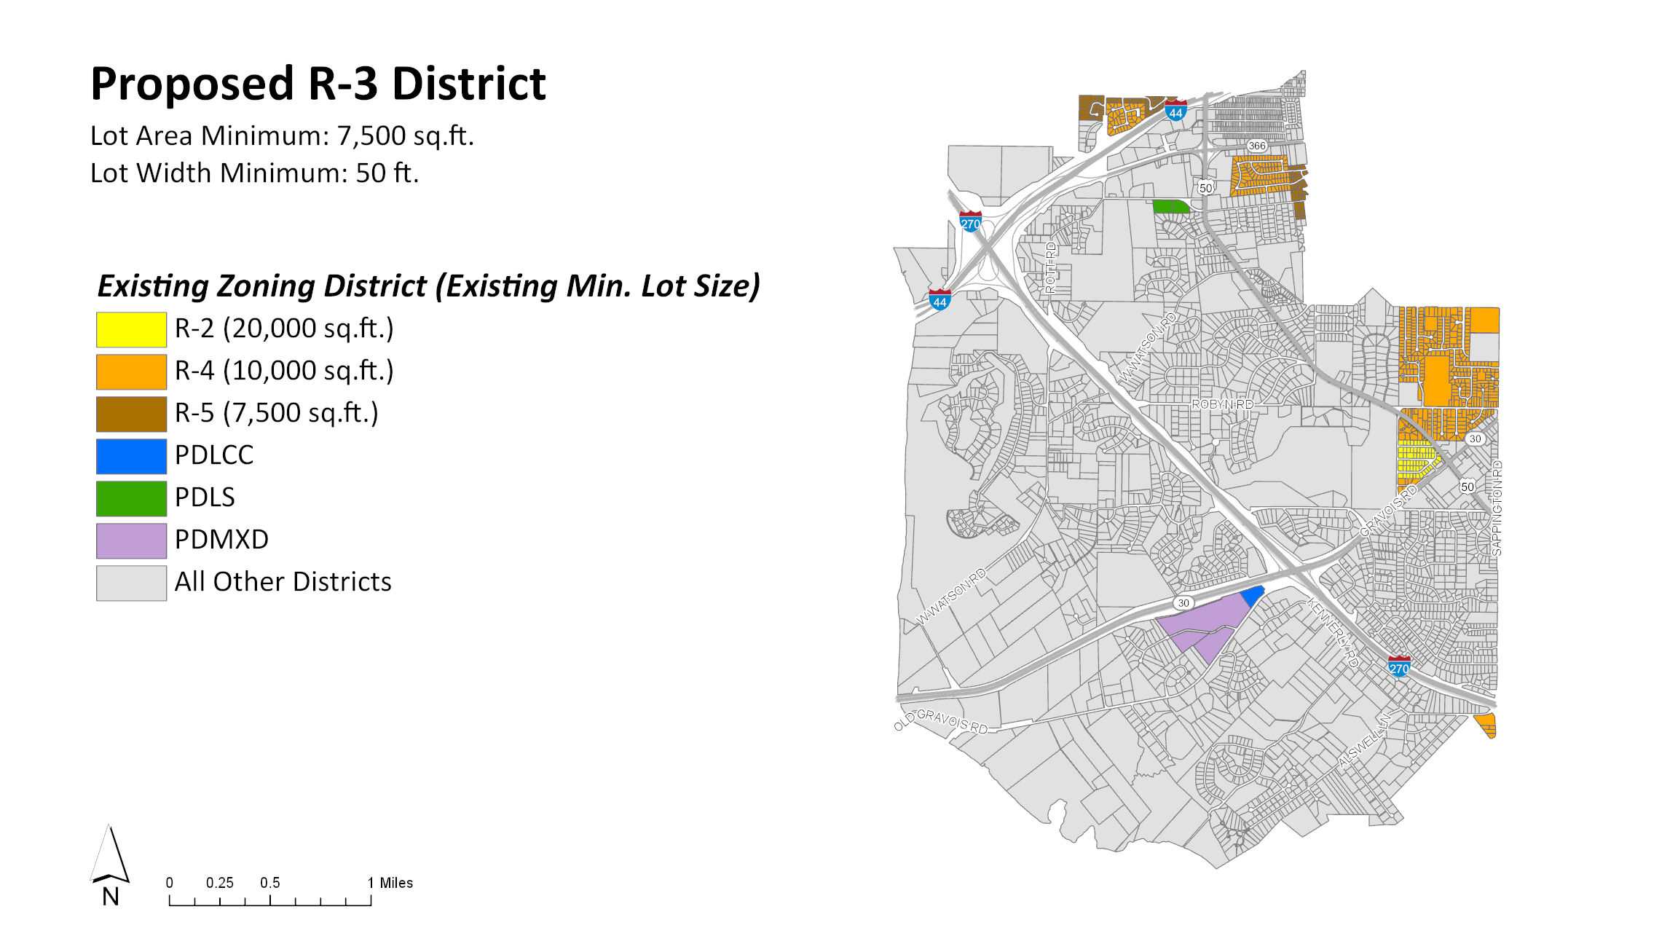
(10,000 sq/ft)
(7,500 sq/ft)
(variable)
(10 acres)

Slide 14
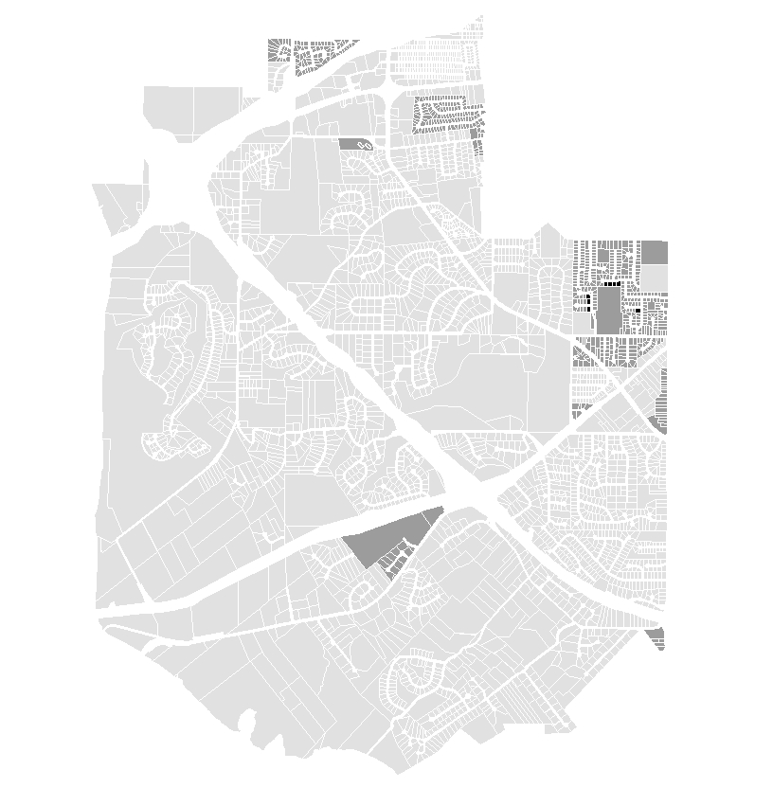
Proposed R-3 District
Lot area minimum: 7,500 sq/ft
Lot width minimum: 50 feet
Formerly:
R-4
lot area minimum: 10,000 sq/ft
lot width minimum: 60 feet
R-5
lot area minimum: 7,500 sq/ft
lot width minimum: 50 feet
 | _{R-3 District Parcels}
 | New Opportunities for Subdivision
 | _{All Other Parcels}

Slide 15
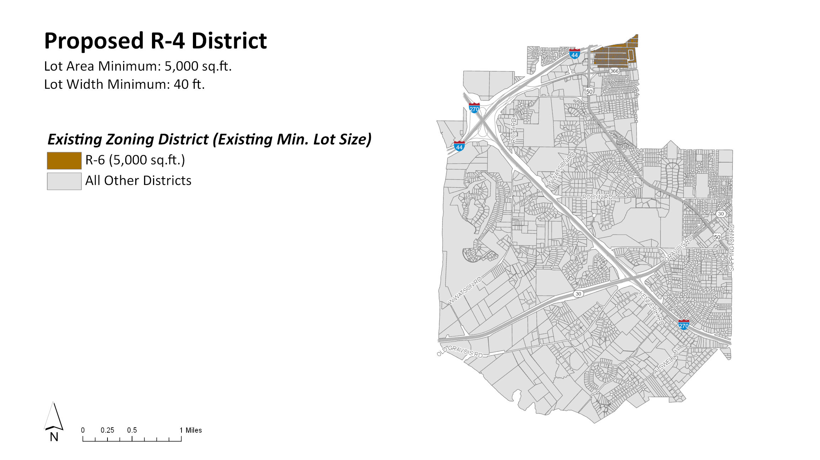

Slide 16
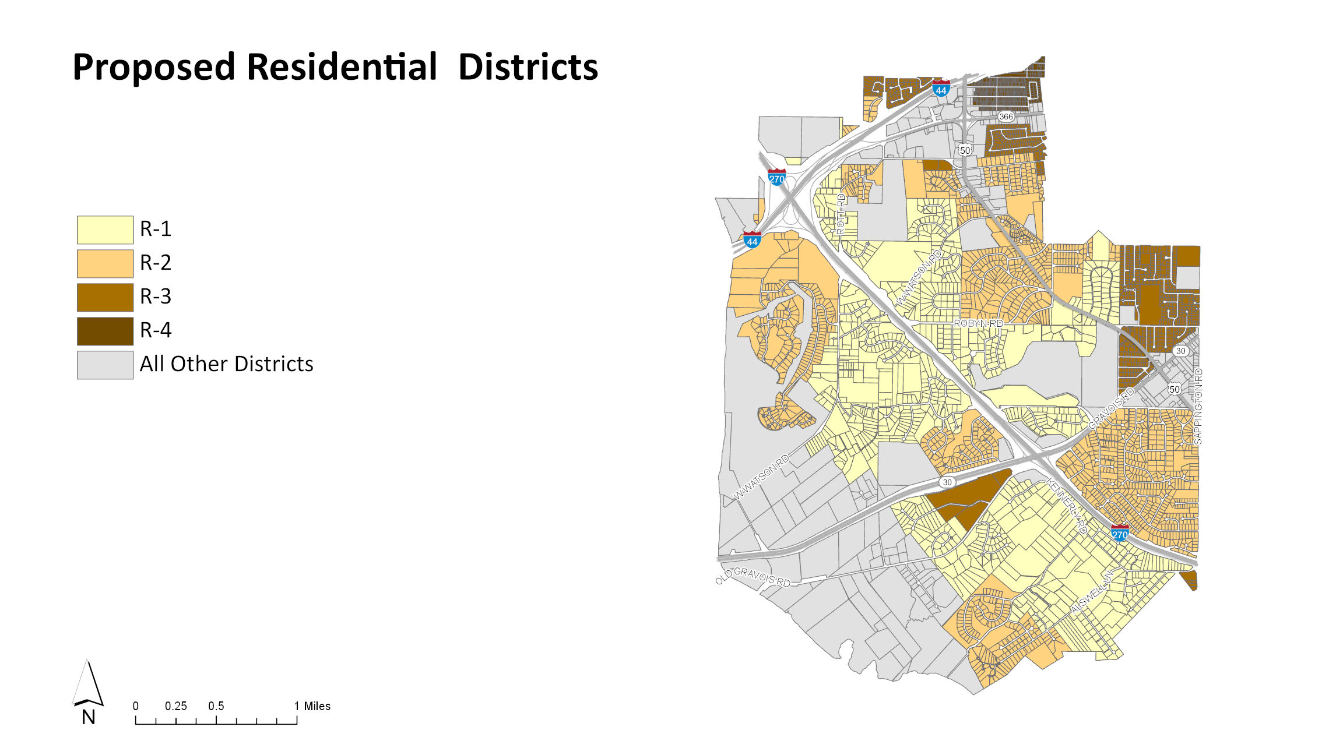

Slide 17
Commercial/Industrial District Changes
PROPOSED DISTRICT | EXISTING DISTRICTS
LC | C1
 | PDBC
 | PDLC (A)
 | PDLC (B)
 | PDLC (C)
GC | C1
 | PDLC (C)
 | PDBC
 | R-1
PO | R-1
 | PDBC
 | PDLC (C)
LI | C1
 | PDLI

Slide 18
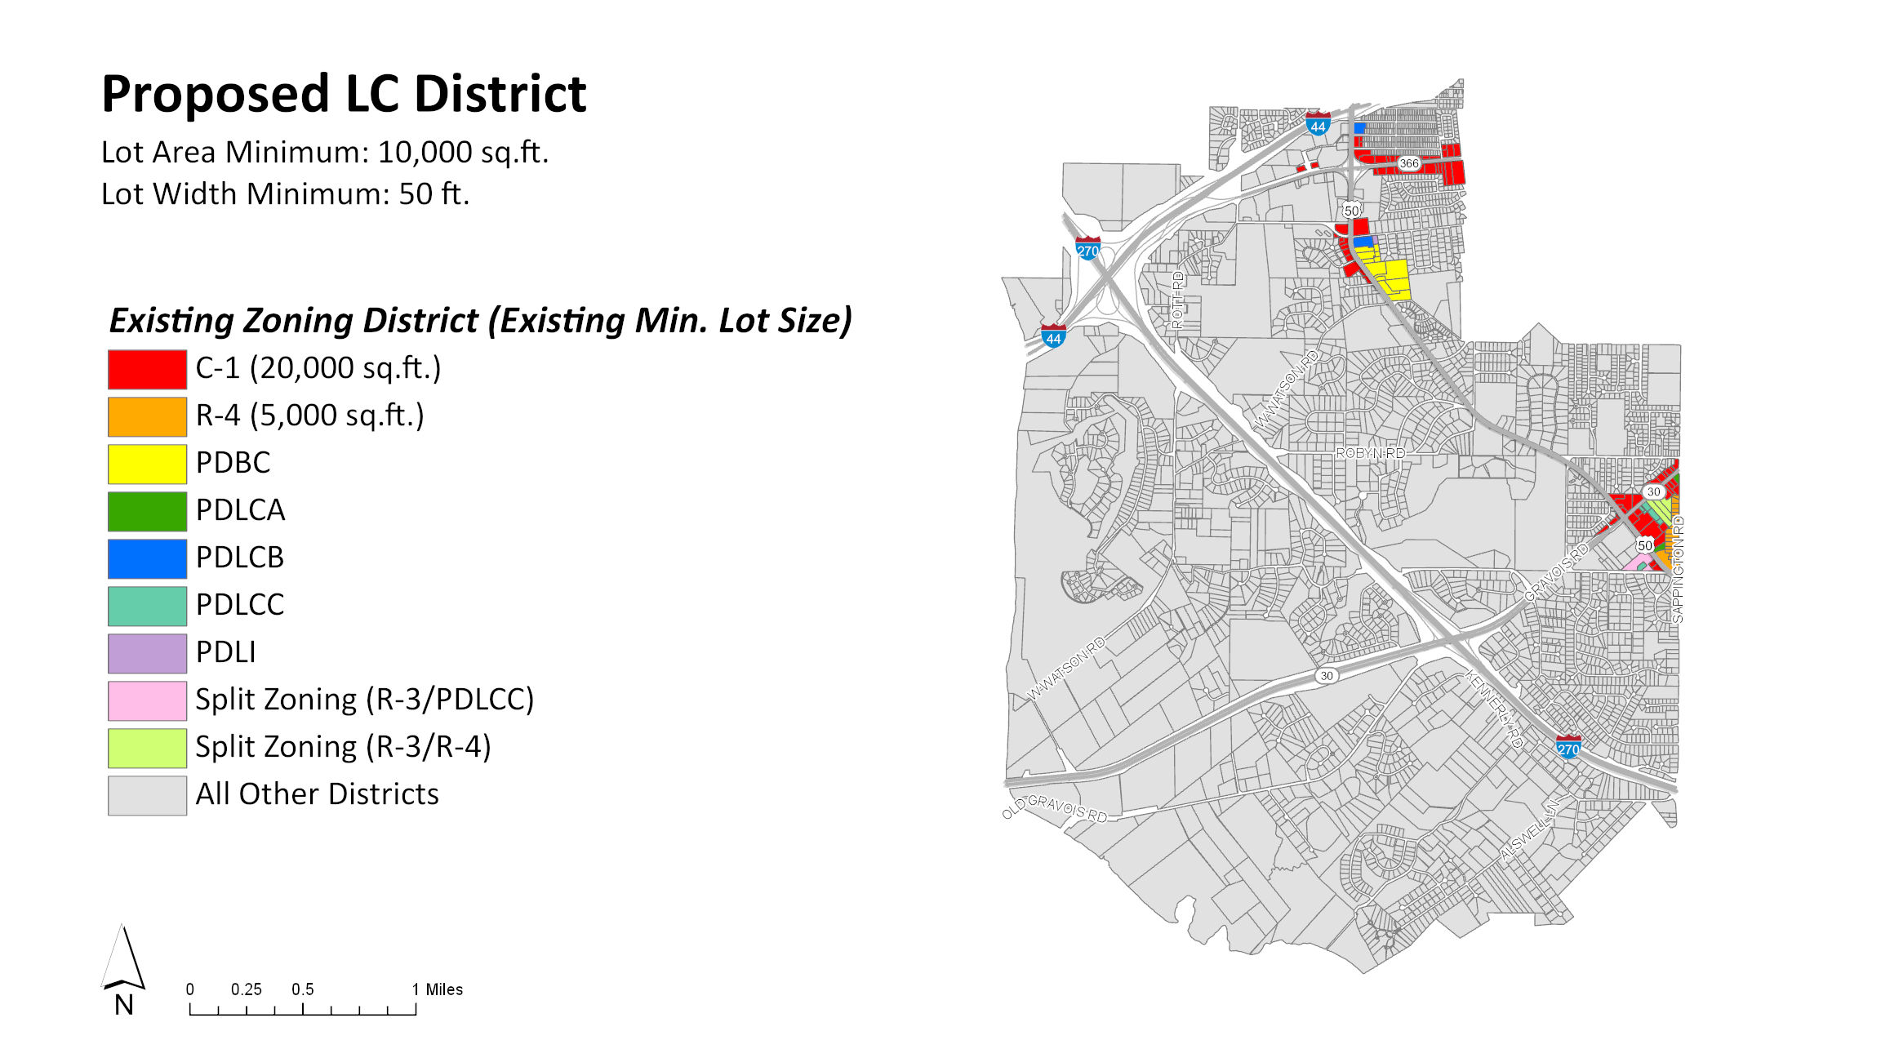

Slide 19
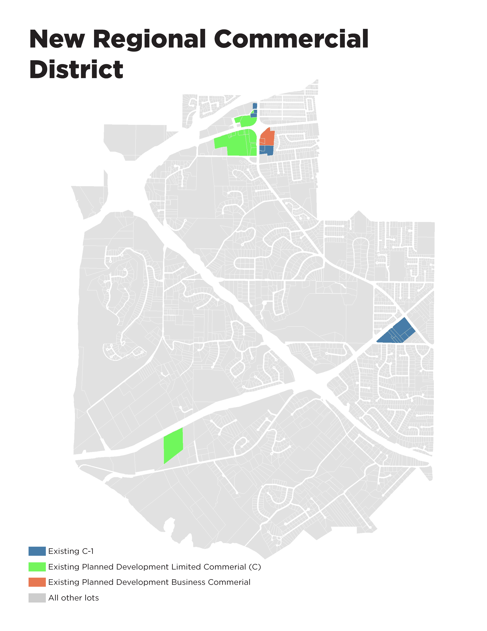
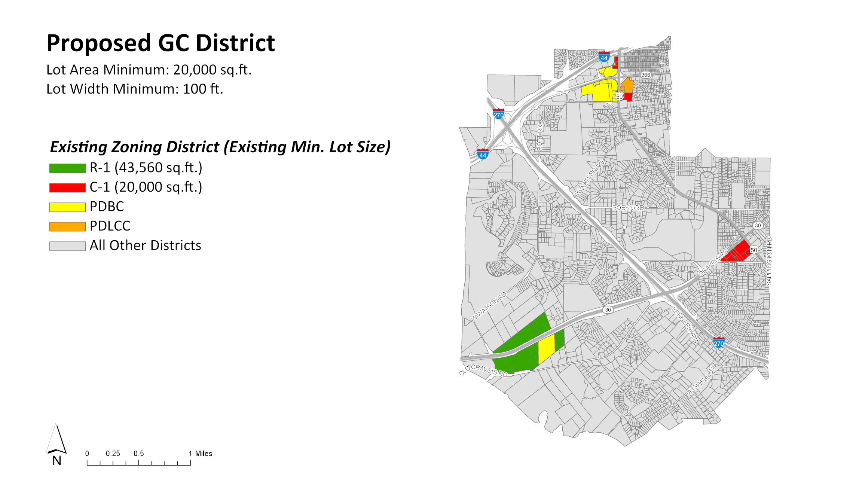
(20,000 sq/ft)
(3-10 acres)
(10 acres)
Existing Undeveloped R1 Single Family

Slide 20
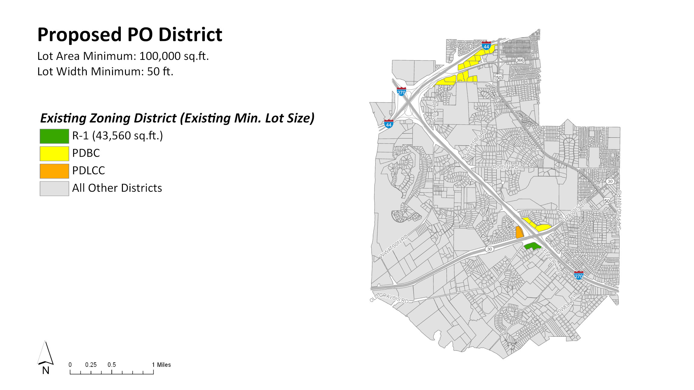

Slide 21
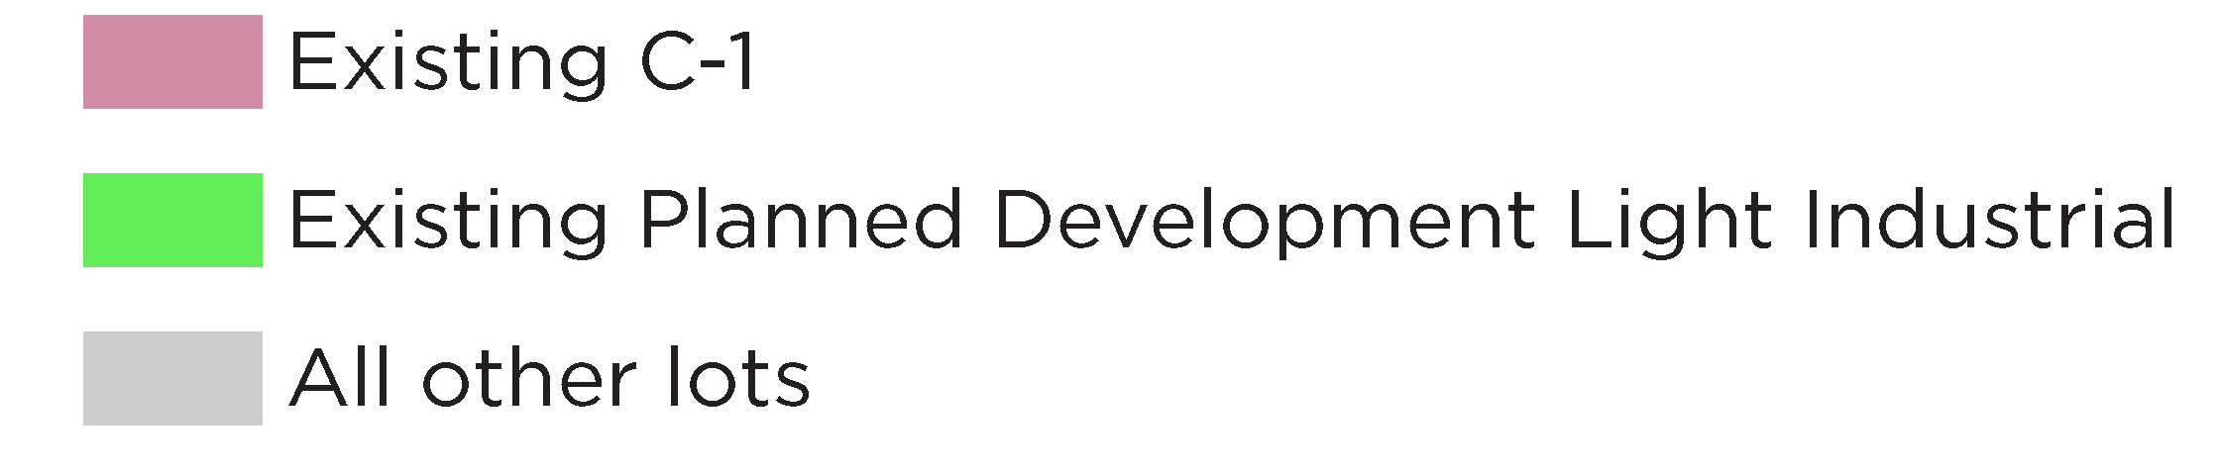
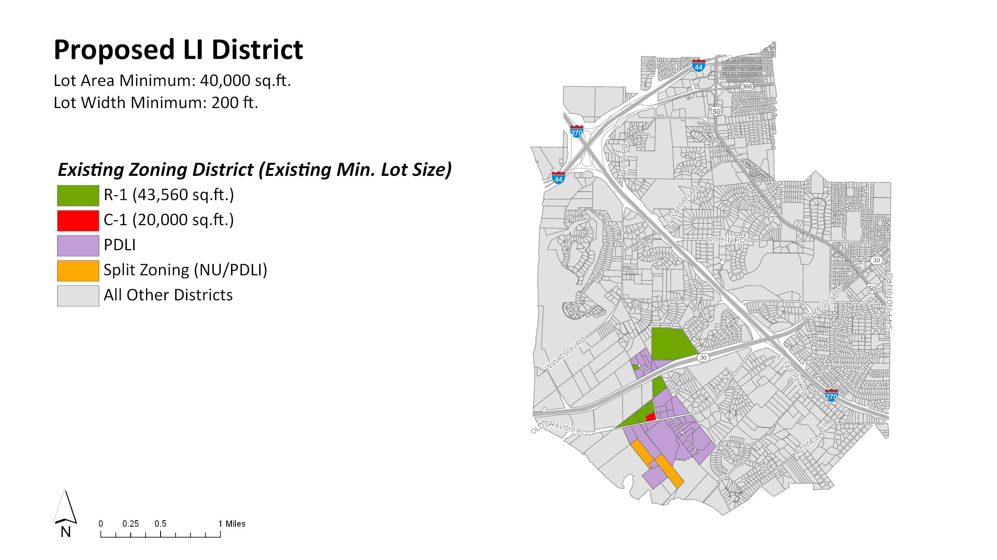
(20,000 sq/ft)
(10 acres)

Slide 22
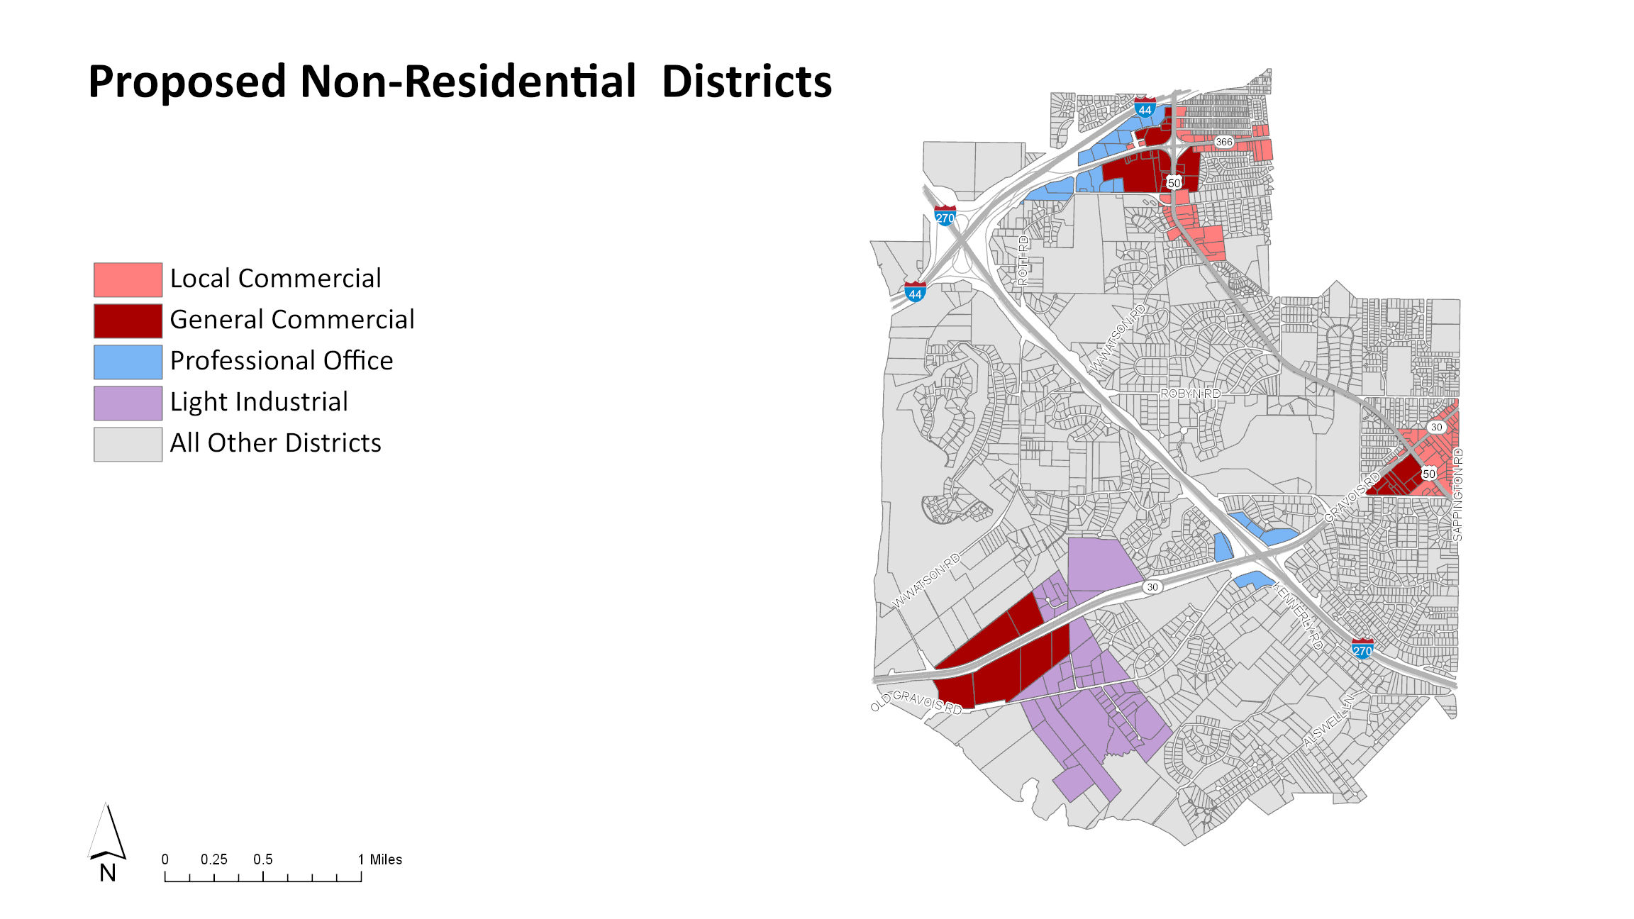

Slide 23
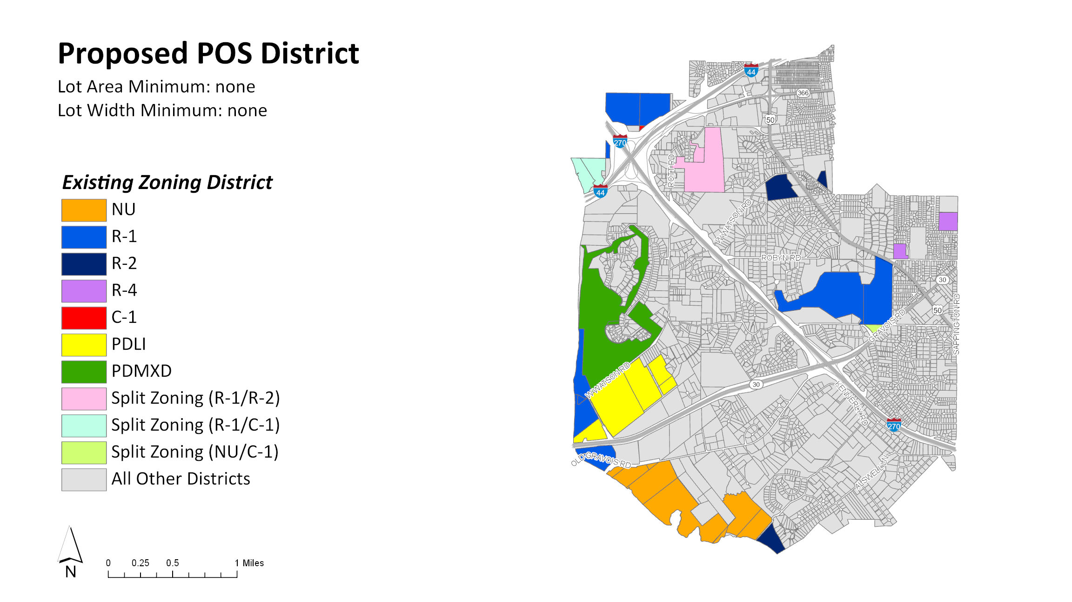

Slide 24
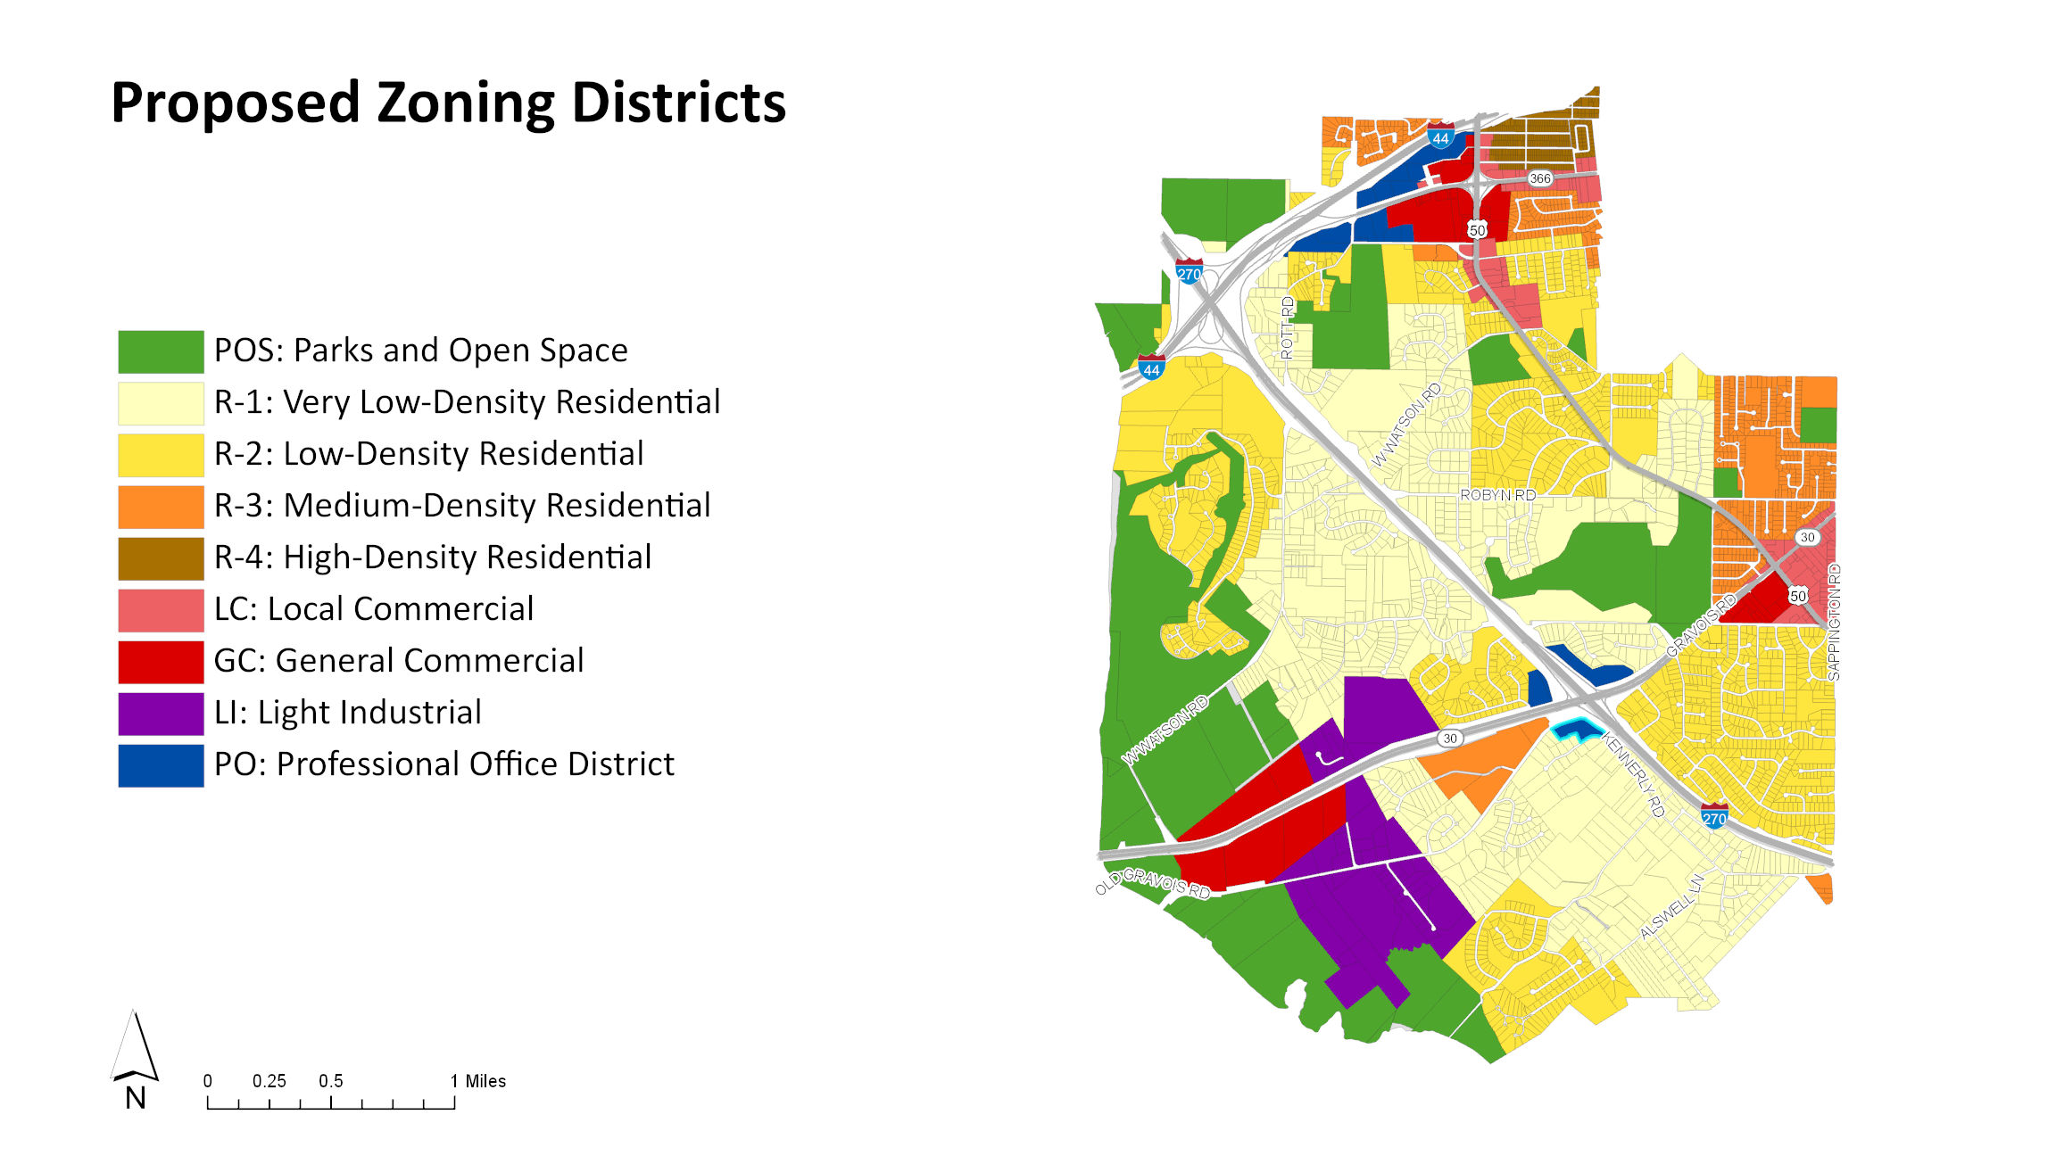

Slide 26
Current Zoning Districts
Proposed Zoning Districts
NU
R-1
R-2
R-3
R-4
R-5
R-6
C-1
PD-R
PD-RC
PD-BC
PD-LC (A)
PD-LC (B)
PD-LC (C)
PD-MXD
PD-LS
PD-LI
R-1
R-2
R-3
R-4
LC
GC
PO
LI
POS

Slide 27
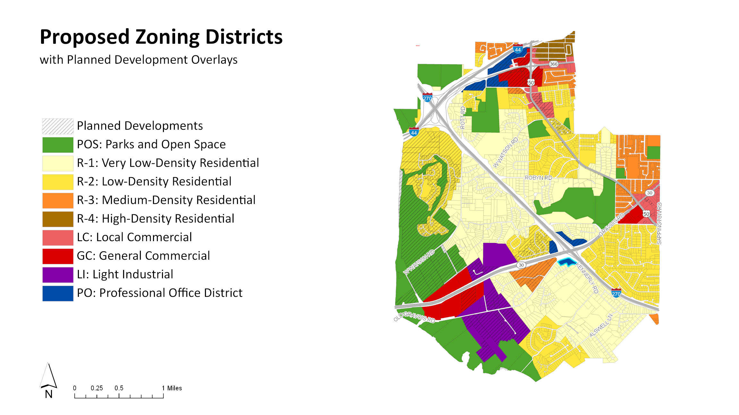

Slide 28
DISCUSSION

Slide 29
Proposed District Standards
DISTRICT | LOT AREA (sq/ft) | LOT WIDTH (ft) | FRONT (ft) | INTERIOR SIDE (ft) | SIDE ADJACENT TO STREET (ft) | REAR (ft) | PRIMARY USE COVERAGE (%) | IMPERVIOUS SURFACE COVERAGE (%) | TOTAL LOT COVERAGE (%) | HEIGHT
POS | N/A | N/A | N/A | N/A | N/A | N/A | N/A | N/A | N/A | N/A
R-1 | 43,560 | 150 | 50 | 15 | 50 | 35 | 15 | 5 | 20 | 40
R-2 | 15,000 | 80 | 40 | 10 | 40 | 30 | 20 | 5 | 25 | 40
R-3 | 7,500 | 50 | 30 | 7 | 30 | 30 | 25 | 5 | 30 | 40
R-4 | 5,000 | 40 | 20 | 3 | 20 | 15 | 60 | 5 | 65 | 40
LC | 10,000 | 50 | 10 | 0 (a) | 10 (a) | 25 (a) | N/A | N/A | 85 | 50
GC | 20,000 | 100 | 10 | 0 (a) | 10 (a) | 0 (a) | N/A | N/A | 80 | 75
LI | 40,000 | 200 | 10 | 0 (a) | 10 (a) | 0 (a) | N/A | N/A | 80 | 50
PO | 100,000 | 50 | 40 | 15 (a) | 40 (a) | 30 (a) | 65 | 10 | 70 | 50
a) If setback is adjacent to a residential district, then same as residential district.

Slide 30
Why are changes being proposed?
Establish underlying zoning for Planned Development Districts
Eliminate non-conformities
 | Total # Lots | # Nonconforming Lots | % Nonconforming Lots
Existing Residential Parcels | 3,181 | 829 | 26%
Proposed Residential Parcels | 3,827 | 639 | 17%

